Slide 1
Virtual Afwi
Tyler Brunelle

Slide 2
Overview
Background
User Stories
Major Project Constraints
Current State
Expected Demo

Slide 3
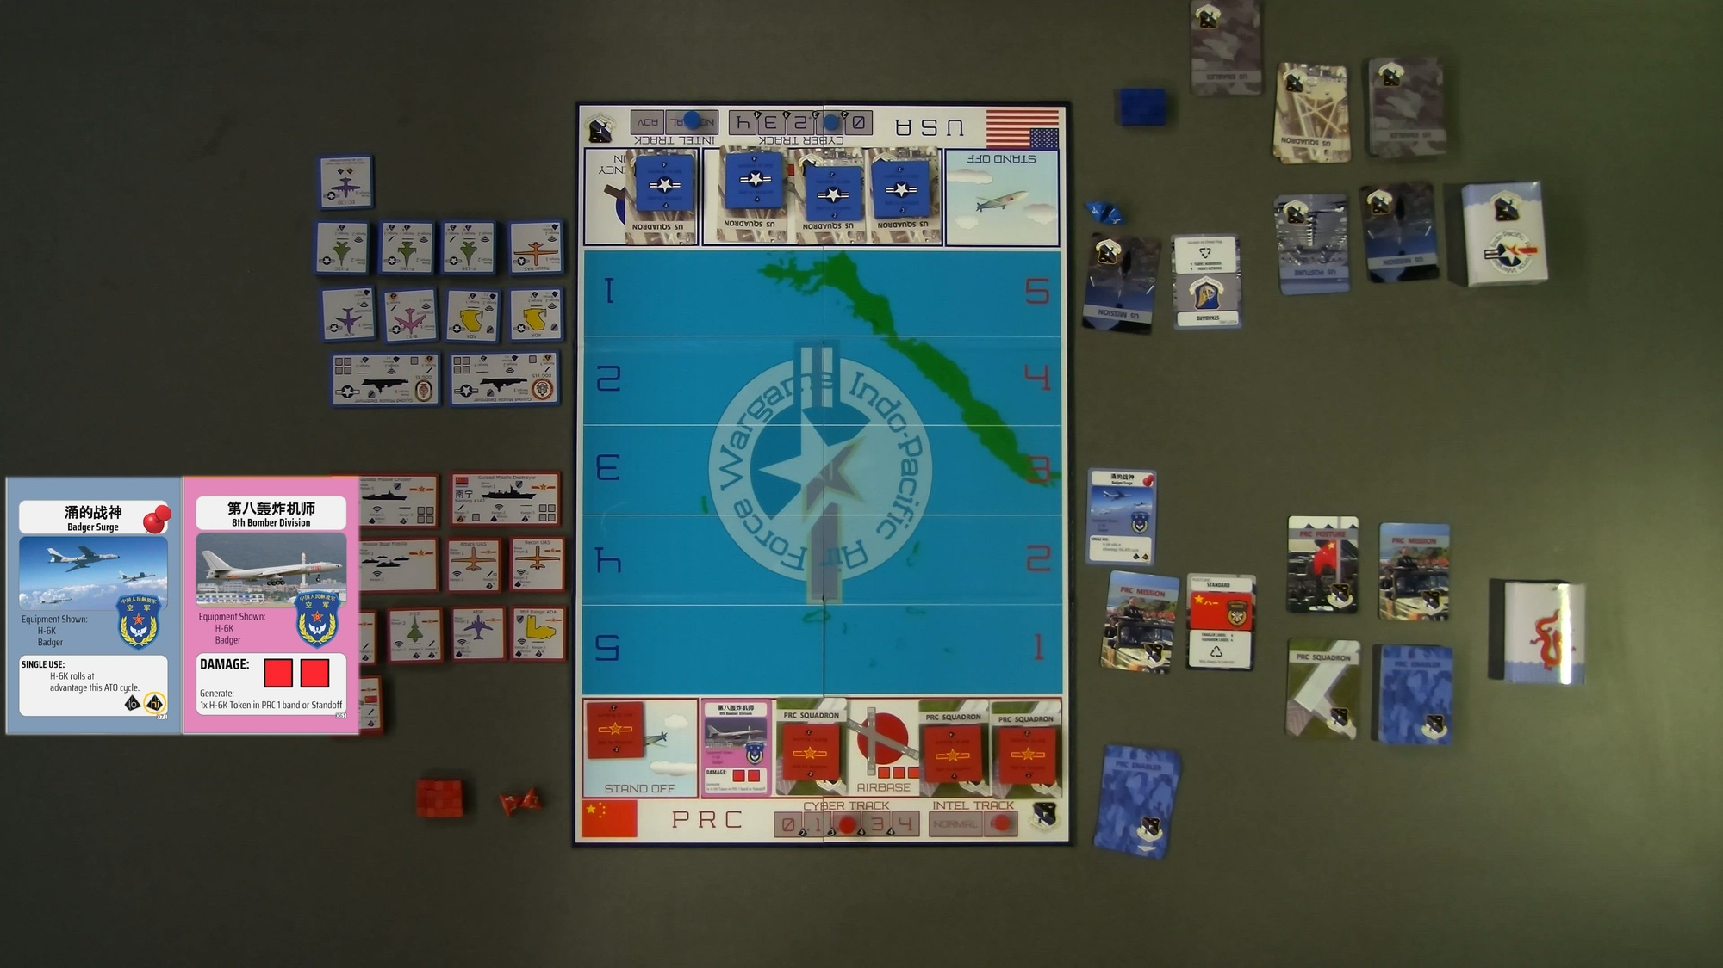

Title
Virtual AFWI
  Purpose
    Digital version of an existing board game, AFWI
  Goals
    Player v Player
    Online
    Tutorial
    Improve game dev skills

Slide 4
Background
Team
Project Advisor
Solo Project!
Dr. Hrishikesh Bhide

Slide 5
User Stories
Player: As a player of this wargame, I want to play AFWI digitally so that I can quickly hone my skills without needing the physical game components
Instructor: As an instructor of the game, I want the program to enforce the rules automatically, allowing players to focus on wargaming instead of rules disputes
New Player: As a new player, I want the game to have some sort of tutorial that teaches the basic mechanics of the game, so that I can quickly learn and start to play others

Slide 6
Major Project Constraints
Ability
Time

Slide 7
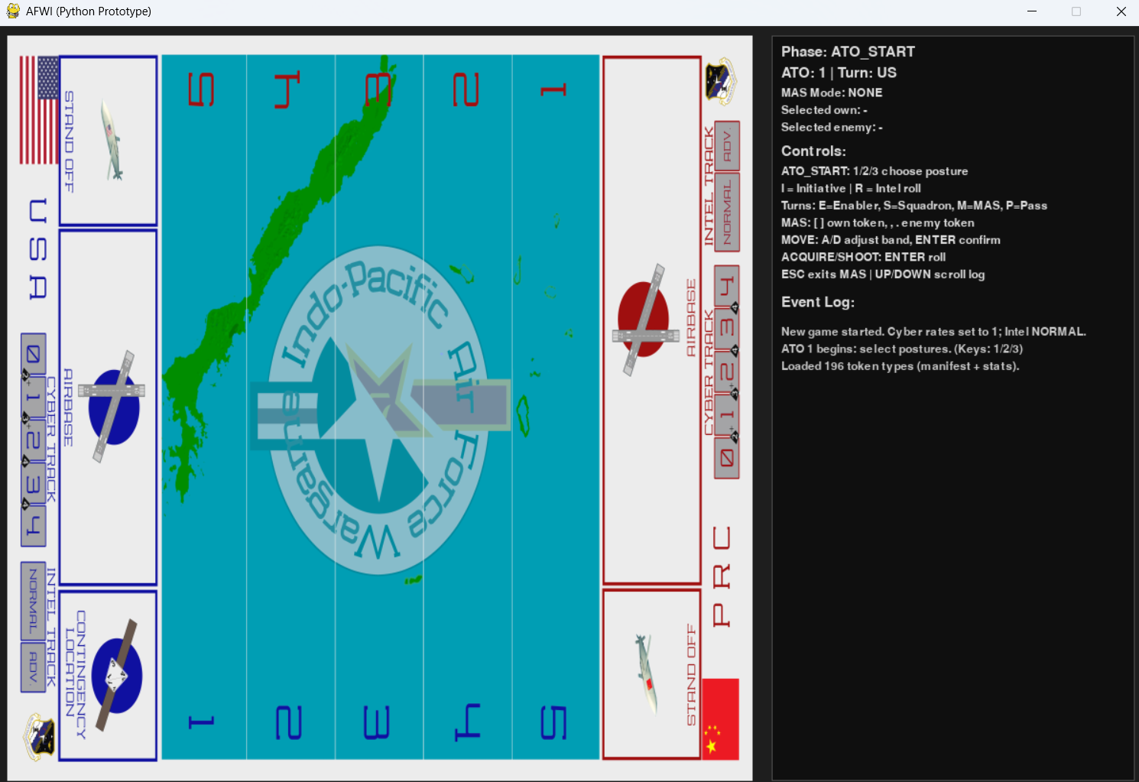
Current state
Visuals
  Basic I/O
  Board
Game Logic
  Turn System
  Squadron Activation
  Move / Acquire / Shoot

Slide 8
Next Steps
Visuals
  Tokens
  Cards
Game Mechanics
  Scoring
  Testing
Online
  Web-Based Connection

Slide 9
Expected Demo
End State
PVP Gameplay
Simple Tutorial

Slide 10
Summary
Background
User Stories
Major Project Constraints
Current State
Expected Demo

